Slide 1


AgroKart
Presented By-
Sagar V. Ashtekar
Ajit Y. Shityalkar

Slide 2
Motivation
Every day new technology is arriving and billions of people were connected to the Internet. Purchasing goods, groceries, clothes everything is online. He or She can able to place the order from their smartphone within a minute. But, Farmers are still lack of benefitting from the internet. As we all knew that Farmers are the backbone of our country and without them, we can't complete a day. Well, this idea is completely dedicated to farmers.

Slide 3
Objectives
The site will guide the farmers in all the aspects to get the products directly from the retailer, get knowledge about how to enhance their soil fertility by providing facility of soil testing and consultation by experts, get access to effective farming techniques through e-learning and centralized approach to view different government’s agriculture schemes including the compensation schemes for farming.

Slide 4
Technology platform used for project
Spring Boot, Hibernate, MySQL , ReactJS, HTML, CSS, Bootstrap, JavaScript.
Why we have used React in our project –
Hassle-free reusability of components.
ReactJs provides high performance reinforced by Virtual DOM.
React has small components which we can use independently.
Unique React hooks. Eg. useState, useEffect
One way data binding.
Provides rich libraries Eg. testify, axios
Why we have used Spring Boot in our project –
Faster Development
Easy and Fast dependency management.
It reduces lots of development time and increases productivity.
It avoids writing lots of boiler plate code ,annotations and XML configurations
It is very easy to integrate Spring boot application with its Spring Ecosystem like Spring JDBC , Spring ORM, spring Data , spring security etc.

Slide 5
UML Diagrams

Slide 6
USE CASE DIAGRAM

Slide 9
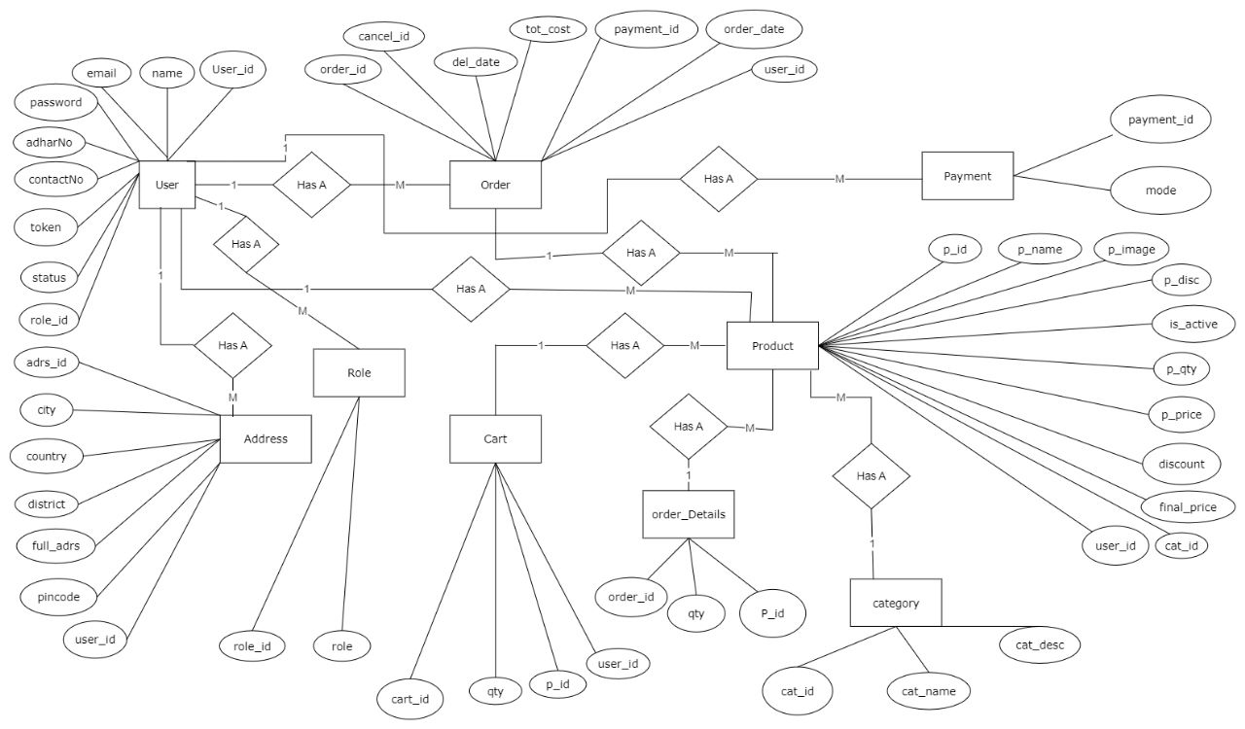
ER DIAGRAM

Slide 10
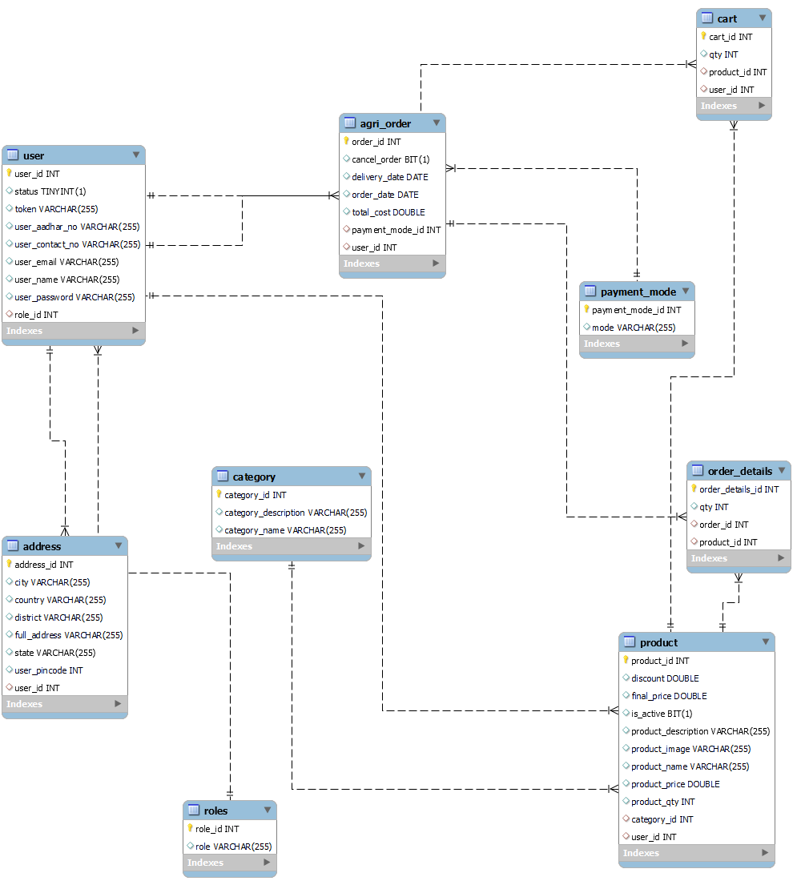
E-R Diagram(MySQL Auto generated)

Slide 11
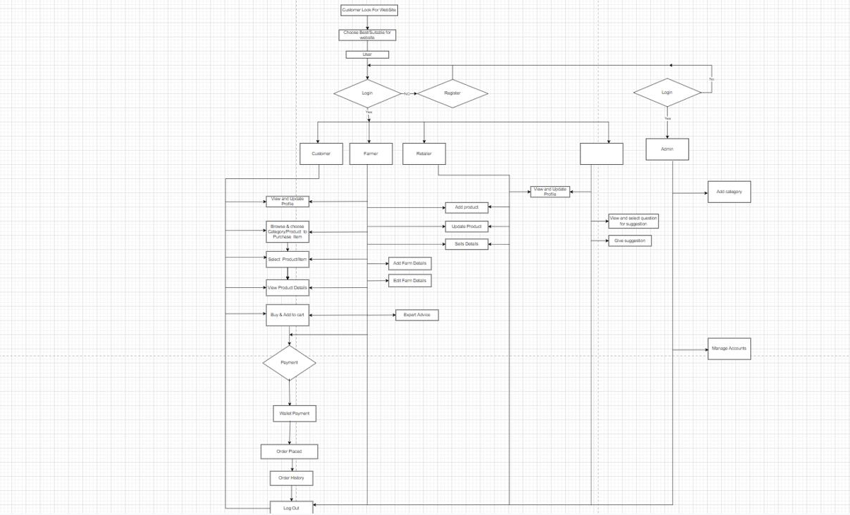
Data Flow Diagram

Slide 12
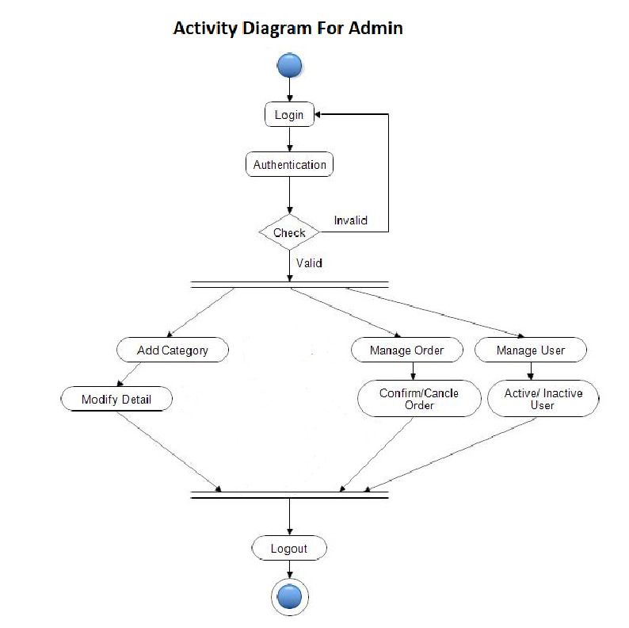

Slide 13
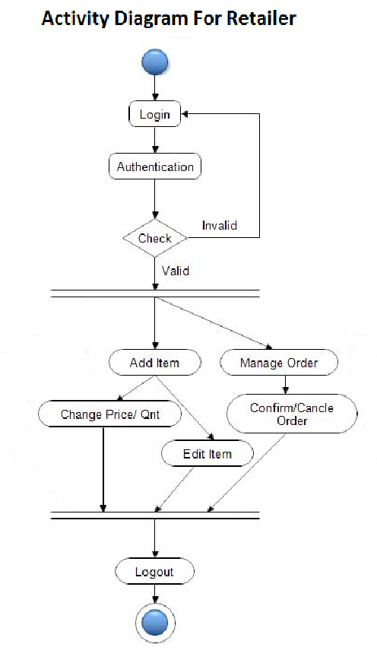

Slide 14
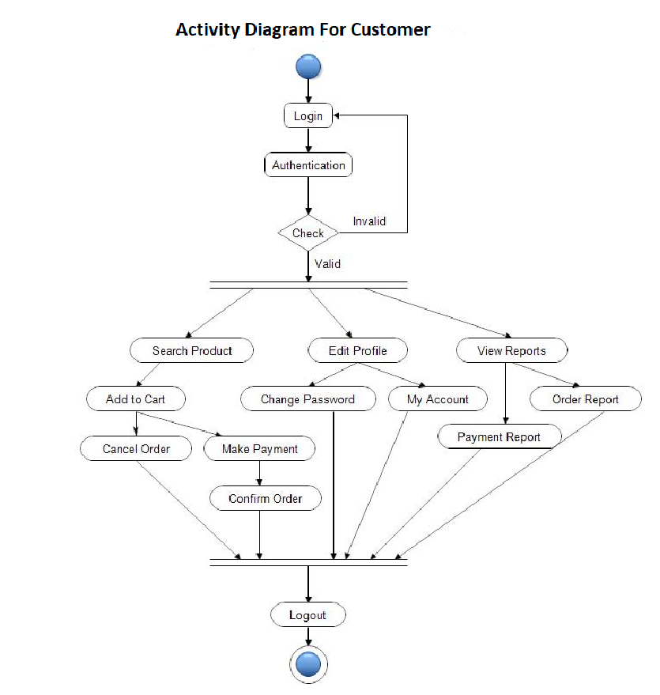

Slide 15
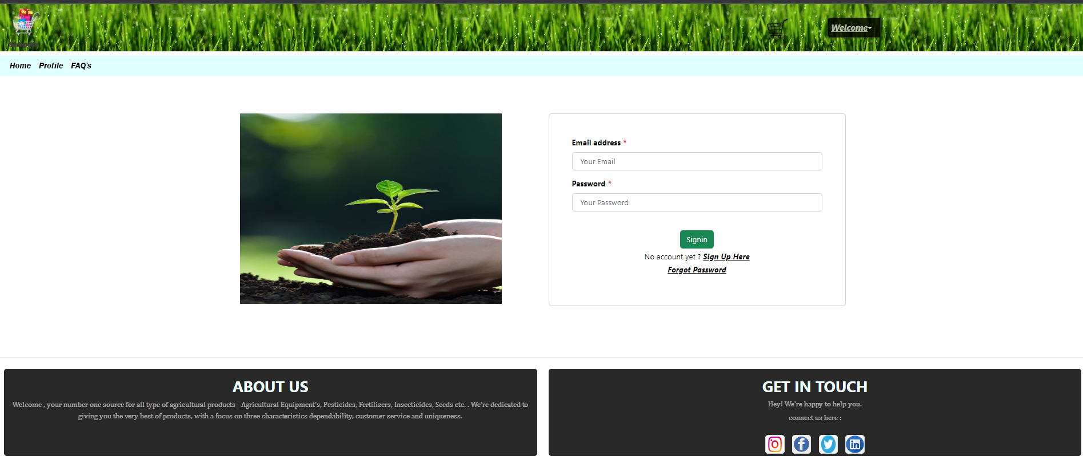
LOGIN

Slide 16
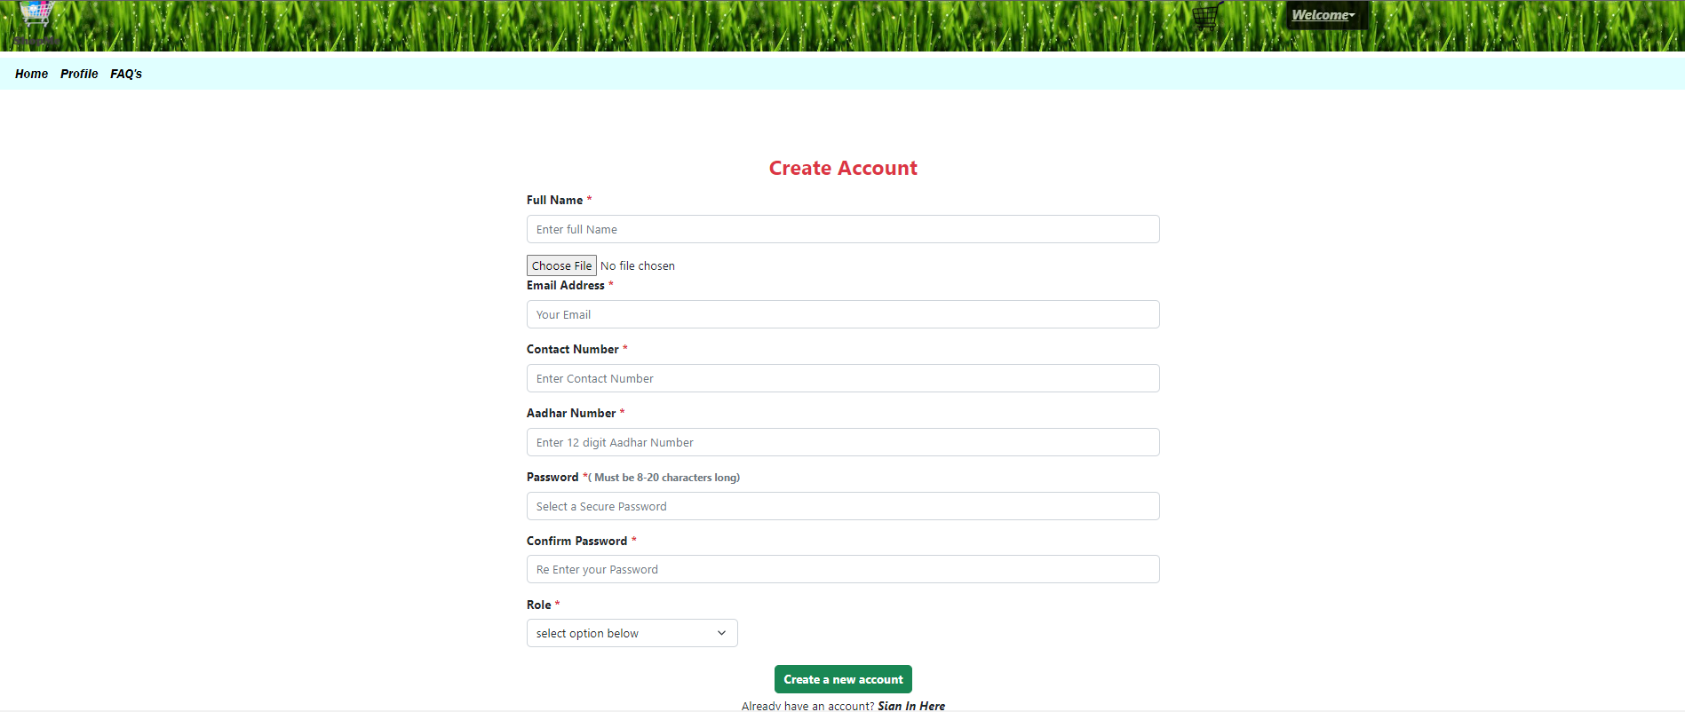
REGISTER

Slide 17
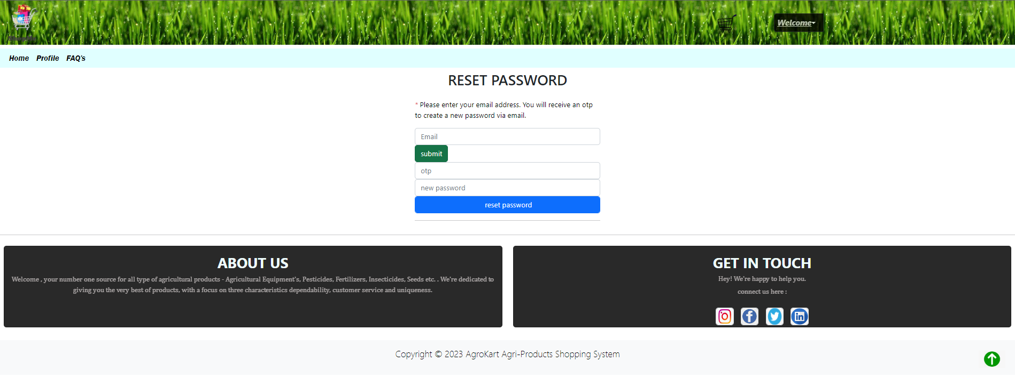
FORGOT PASSWORD

Slide 18
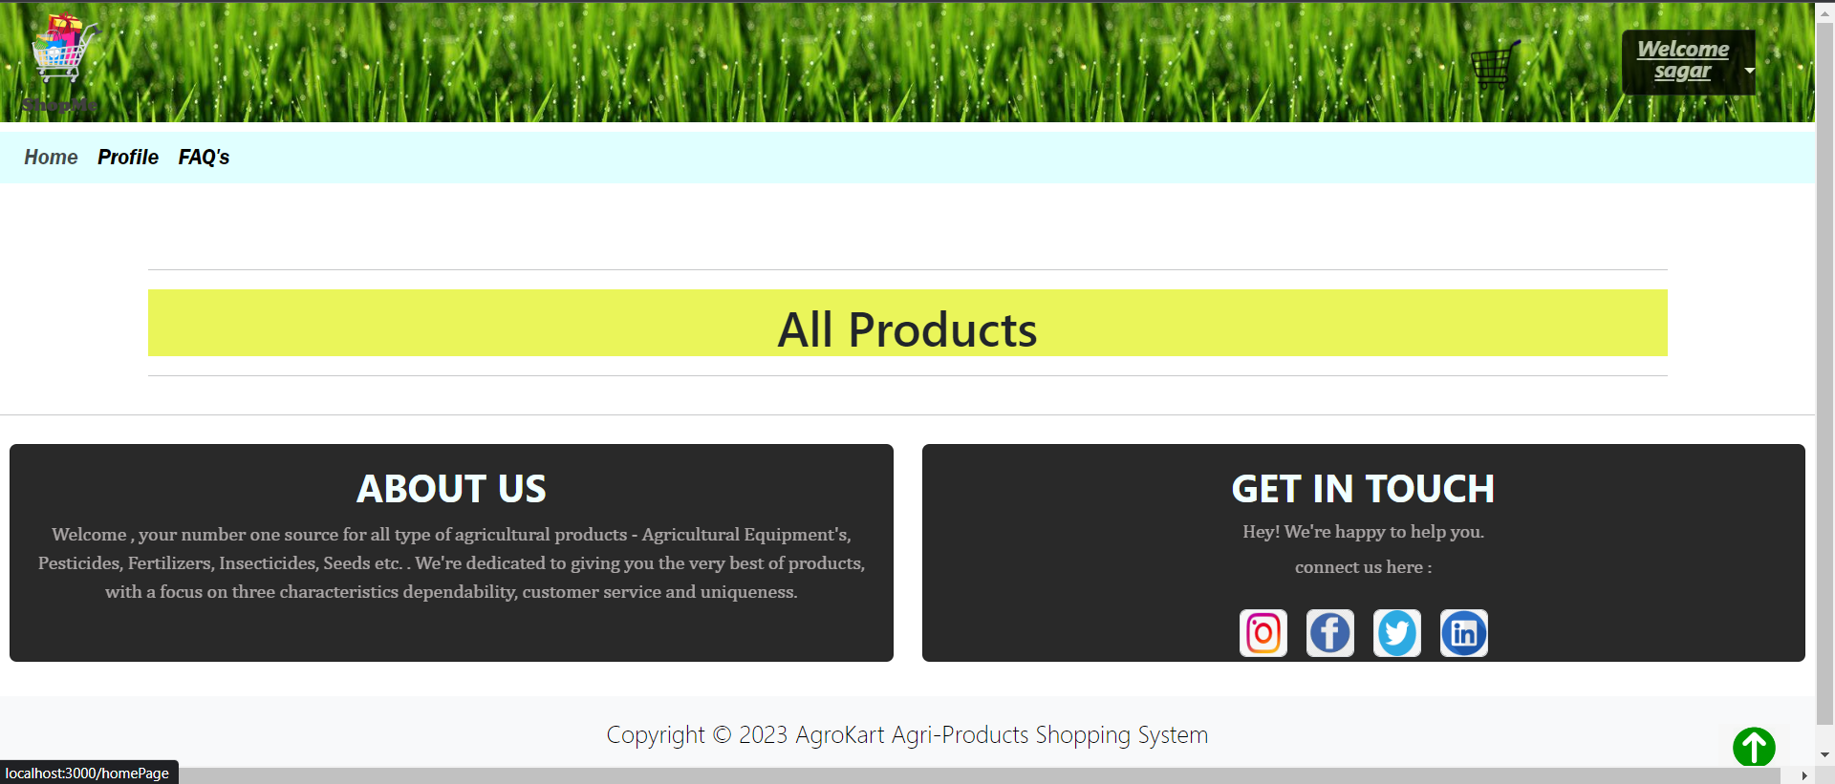
Admin Side

Slide 19
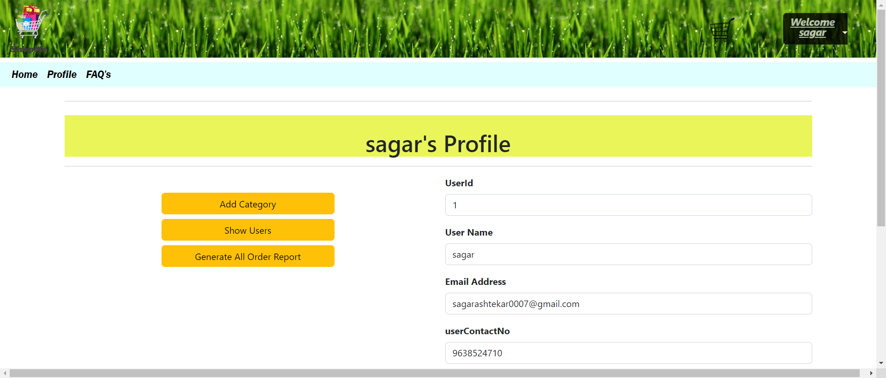

Slide 20
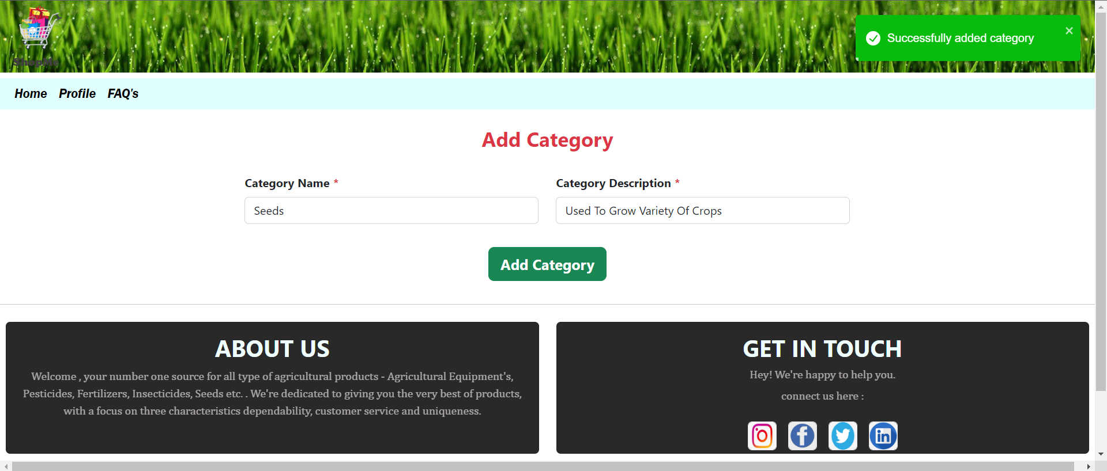

Slide 21
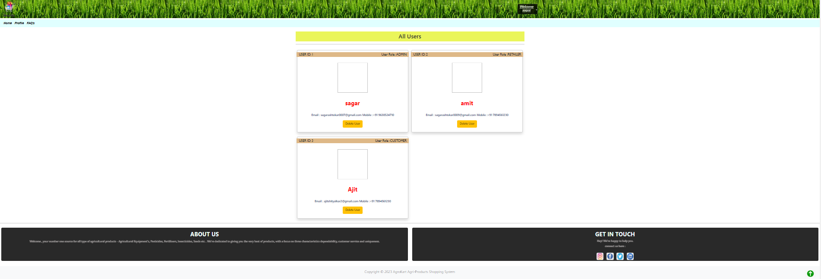

Slide 22
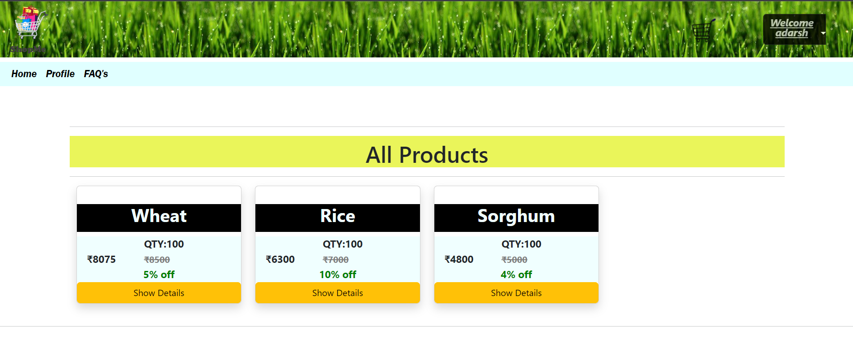

Slide 23
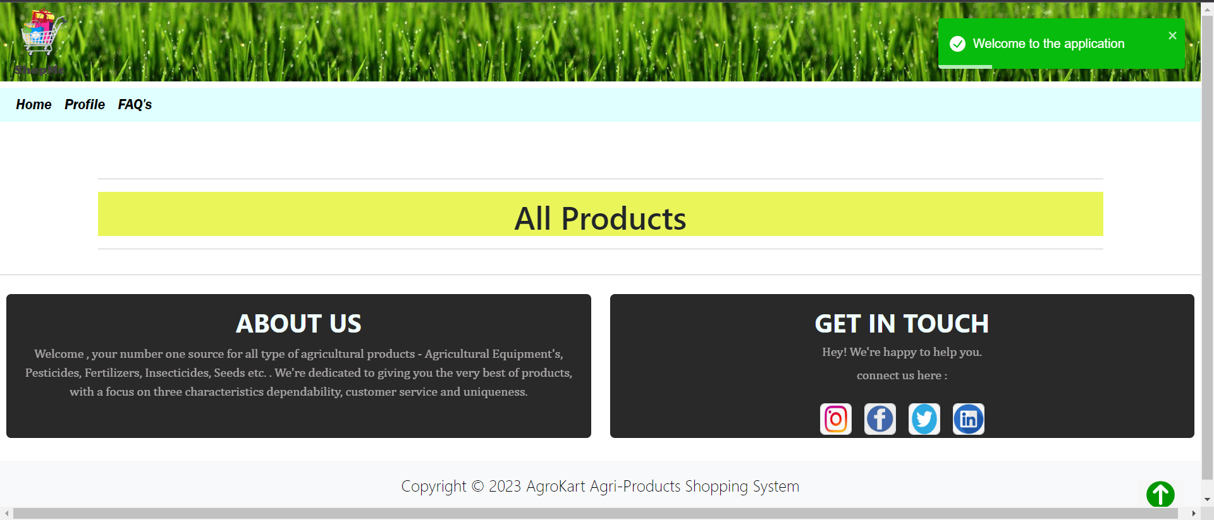
Retailer Side

Slide 24
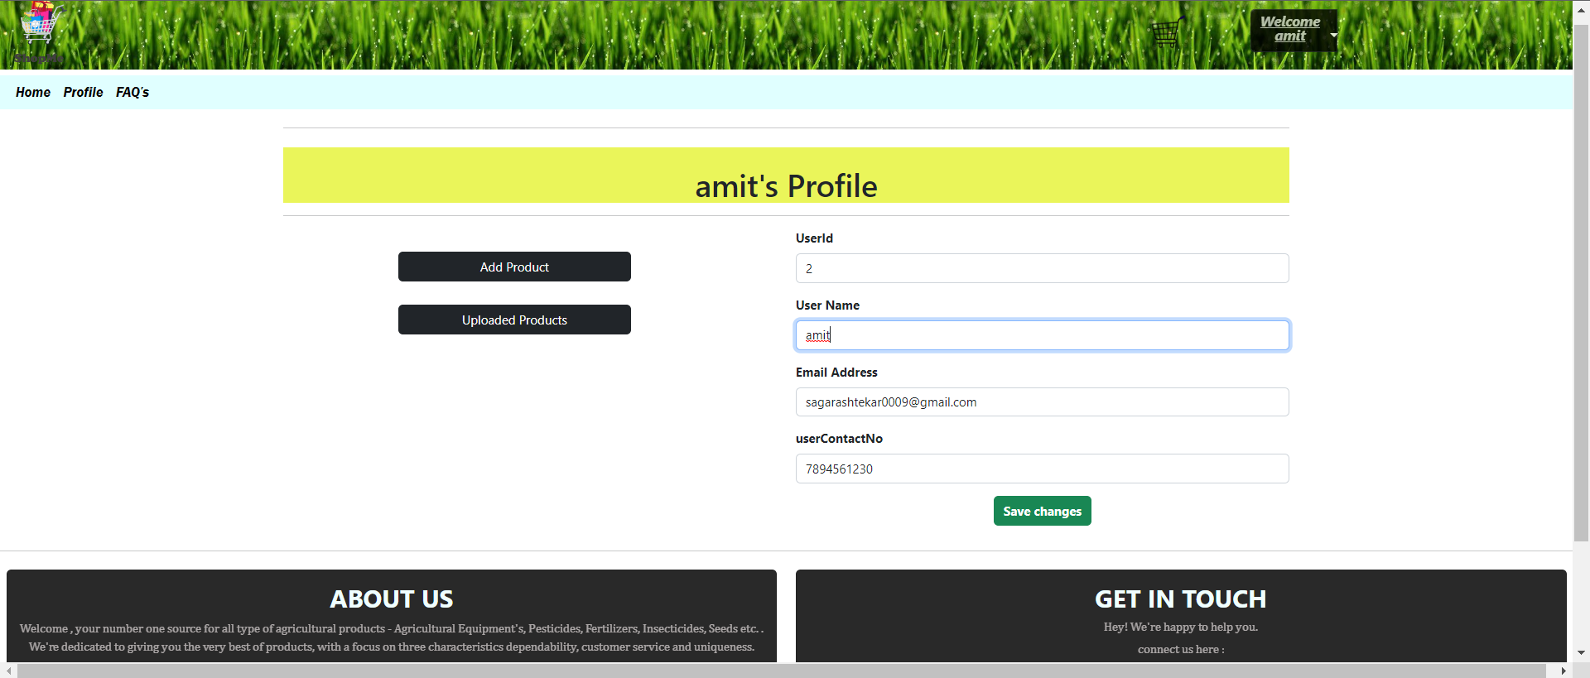

Slide 25
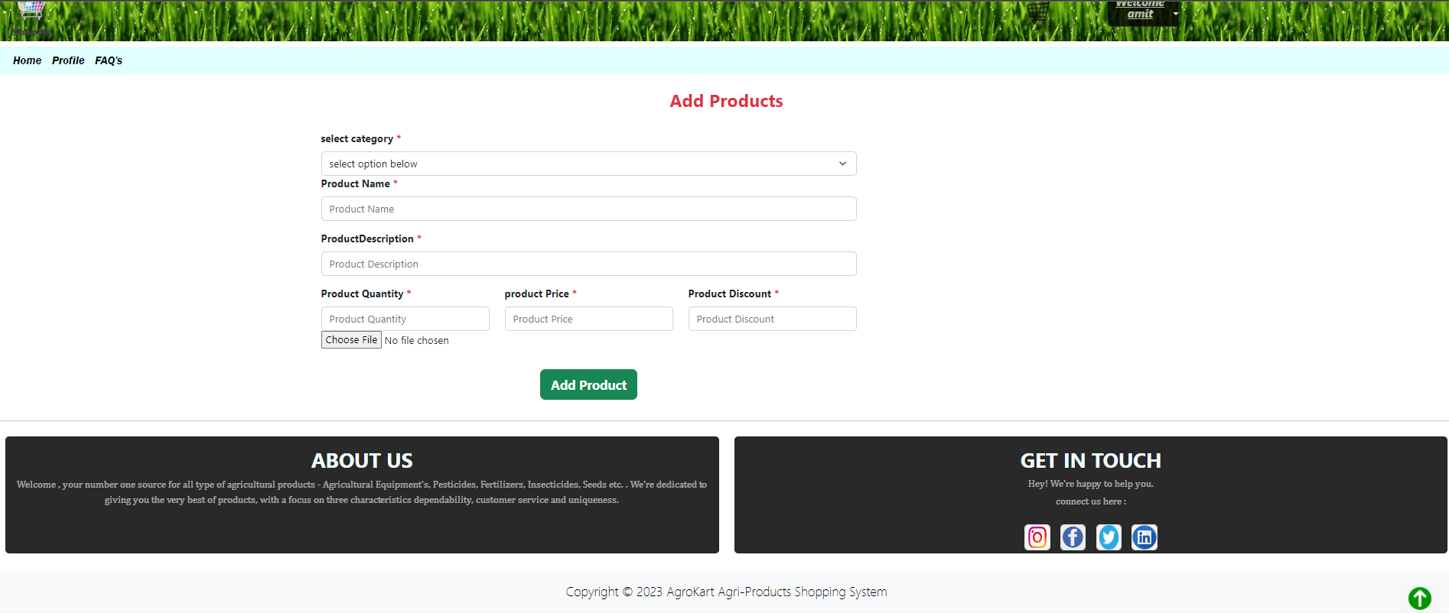

Slide 26
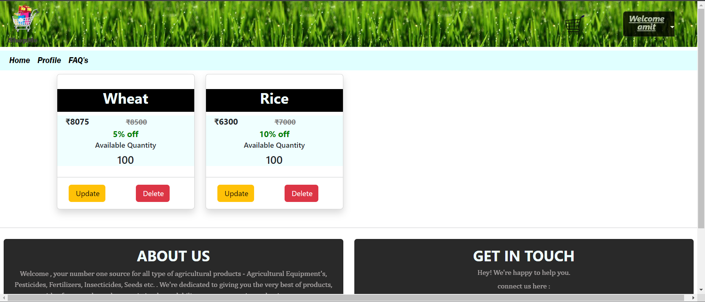

Slide 27
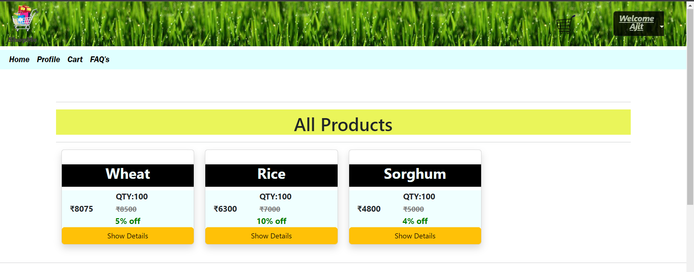
Customer Side

Slide 28
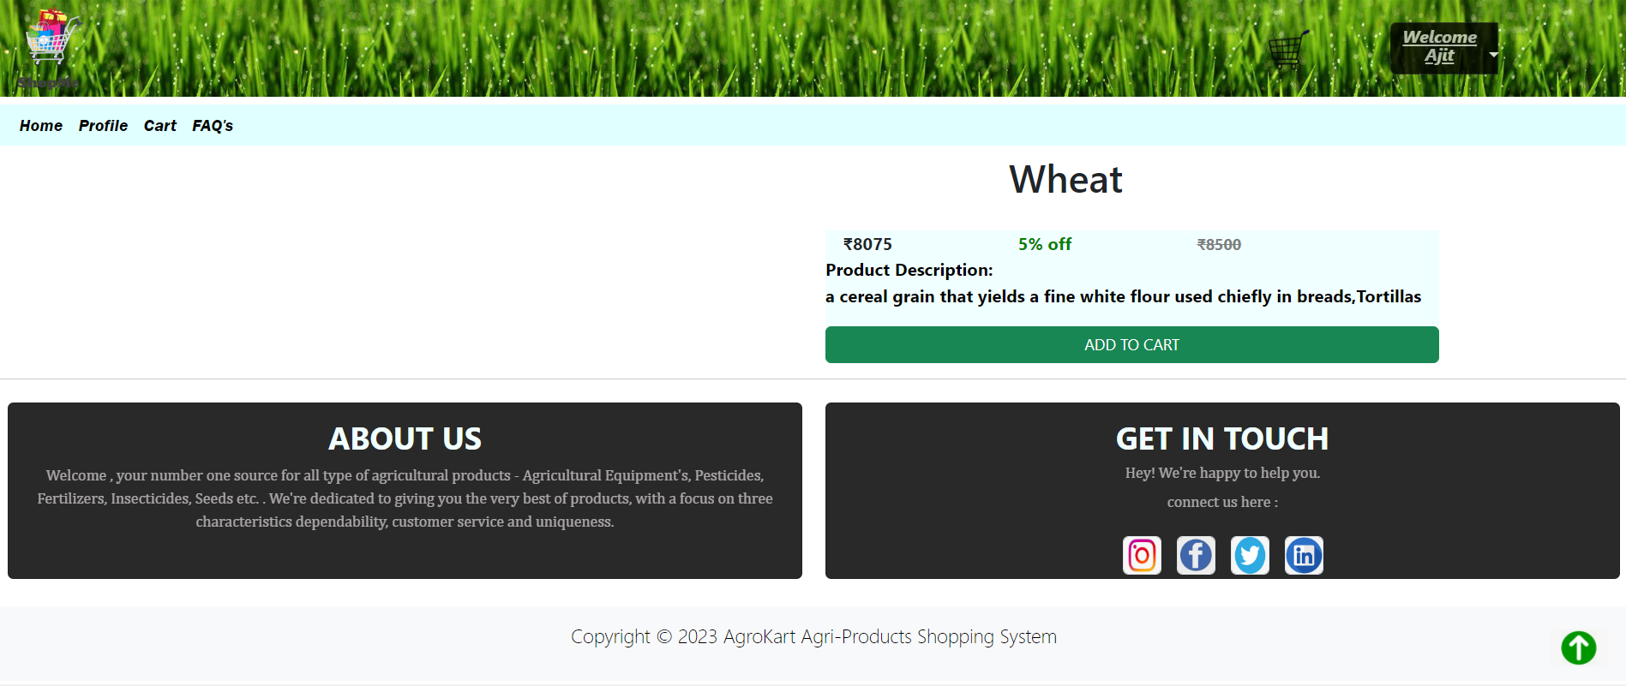

Slide 29
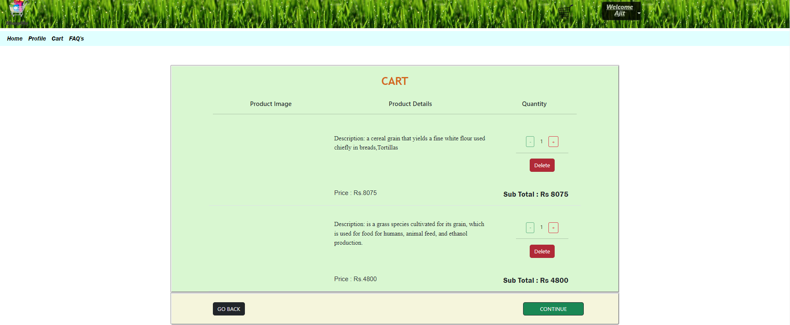

Slide 30
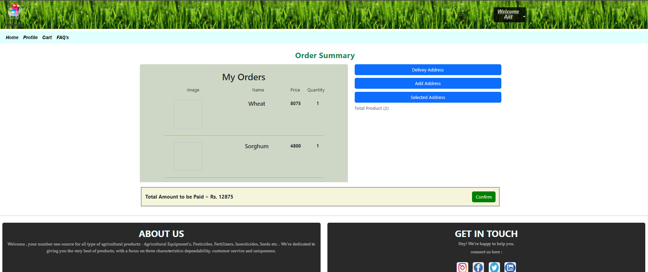

Slide 31
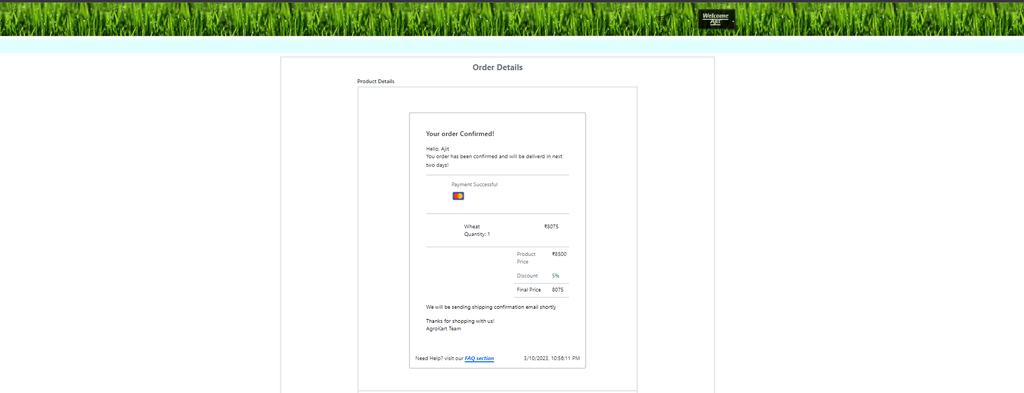

Slide 32
Conclusion
Internet is changing the world. Though it is not possible to entirely switch the Agricultural sector to online mode. But definitely it can help in bridging the gap between Farmers and Seller. Our project AgroKart (online shopping system) serves the purpose of bridging the gap by providing platform for buying and selling agricultural products in online mode. It makes easy for the farmers to search and buy their required products and compare product price and get their required product at required time. Addition to this farmers can get attractive discount on their required product and he can also choose both payment mode option i.e. online payment mode and cash on delivery

